Slide 1
English 7-Chapter 8
Exercise 1
Identifying Sentence Fragments

Slide 2
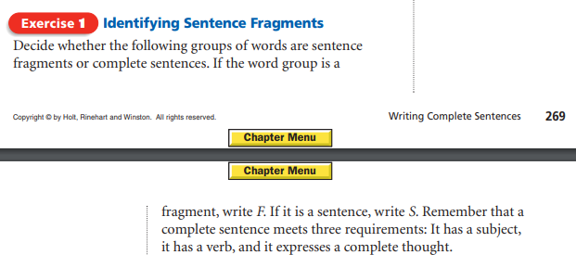

Slide 3
1.
A flying squirrel a squirrel that can gracefully glide through the air.

Slide 4
A flying squirrel a squirrel that can gracefully glide through the air.
F

Slide 5
2.
Some Asian flying squirrels three feet long.

Slide 6
Some Asian flying squirrels three feet long.
F

Slide 7
3.
Skillfully leaps from one tree to another.

Slide 8
Skillfully leaps from one tree to another.
F

Slide 9
4.
The squirrel glides downward, then straight, and finally upward.

Slide 10
The squirrel glides downward, then straight, and finally upward.
S

Slide 11
5.
Some flying squirrels more than fifty feet.

Slide 12
Some flying squirrels more than fifty feet.
F

Slide 13
6.
If they use a higher starting point.

Slide 14
If they use a higher starting point.
F

Slide 15
7.
Flying squirrels live in the forests of Asia, Europe, and North America.

Slide 16
Flying squirrels live in the forests of Asia, Europe, and North America.
S

Slide 17
8.
To eat berries, birds’ eggs, insects, and nuts.

Slide 18
To eat berries, birds’ eggs, insects, and nuts.
F

Slide 19
9.
Nesting in the hollows of trees.

Slide 20
Nesting in the hollows of trees.
F

Slide 21
10.
Notice how this squirrel stretches out its legs to help it glide.

Slide 22
Notice how this squirrel stretches out its legs to help it glide.
S

Slide 23
END!

